Slide 1
DB/Server Presentation
Presented By-
Kirti Tiwari (301999534)
Rucha Shanware (303208131)
Chintan Shah (303190217)

Slide 2
DB Schema & DB Control
Methods

Slide 3
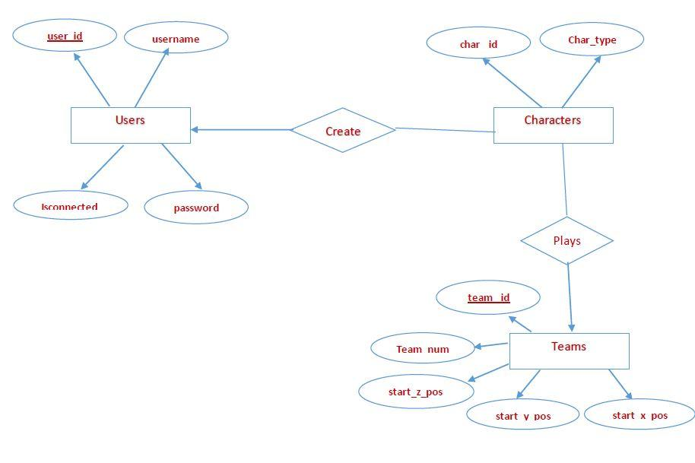
Entity Relation Diagram For MMOG (Contested)

Slide 4
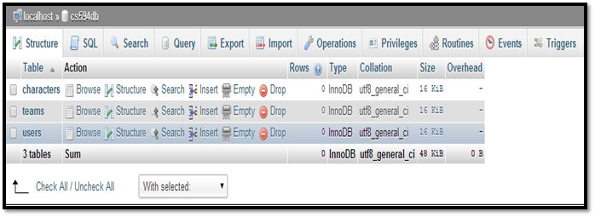
DataBase Schema For MMOG (Contested)
Schema:

Slide 5
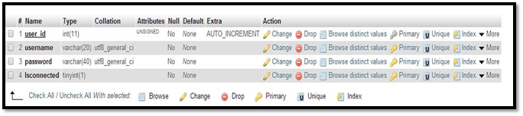
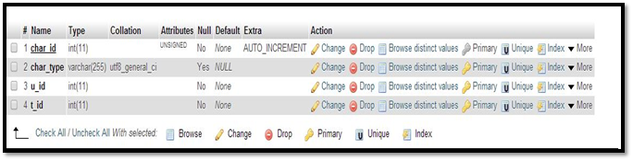
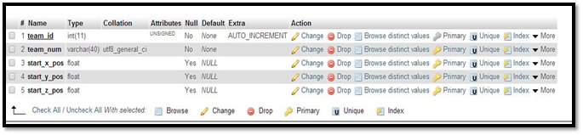
DataBase Tables

Slide 6
Basic Database Control Methods
public void startConnection() --- Setup the connection with the DB.
private void close() ---- close the connection with the DB.
public boolean createAccount(String username, String password)
public boolean hasAccount(String username) --- User Registration
public int getuid(String username) ---- User id of a given user.
public int getcid(int uid) --- Character id of a given user

Slide 7
Basic DataBase Control Methods
public boolean CreateCharacter(String char_type, Integer u_id, Integer t_id)
public boolean hasCharacter(Integer u_id ) ---- Create Character
public String[] GetcharacterLoc(String username, String password, Integer t_id)
public ArrayList<String> getConnectedusers()
public ArrayList<Integer> getConnectedusers_Id()
public String getUsername(int uid)

Slide 8
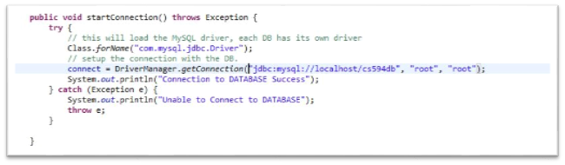
DB Connection Method
public void startConnection()

Slide 9
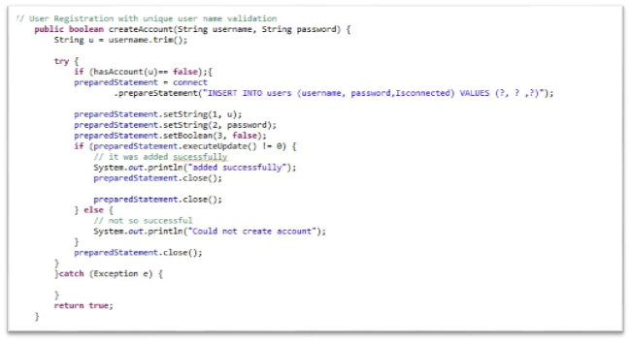
User Registration with unique user name Method
public boolean createAccount(String username, String password)

Slide 10
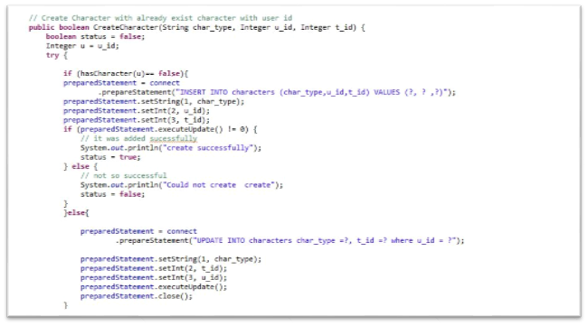
Character Creation Method
public boolean CreateCharacter(String char_type, Integer u_id, Integer t_id)

Slide 11
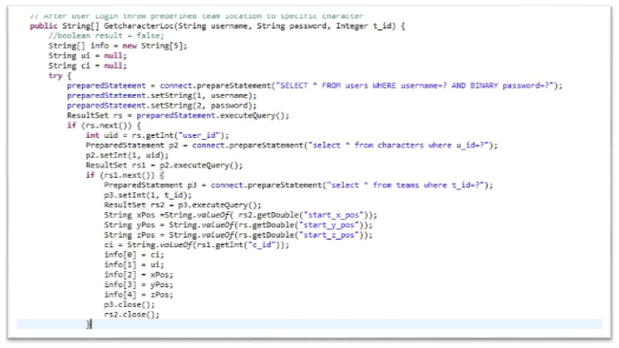
Character Location in environment Method
public String[] GetcharacterLoc(String username, String password, Integer t_id)

Slide 12
Introduction to request and response
By Rucha Shanware

Slide 13
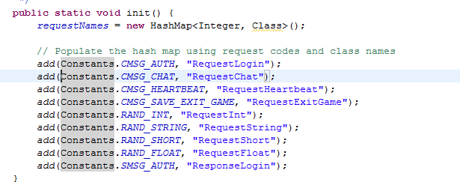
Request Processing
HashMap : that assigns a name to all the request protocols constants

Slide 14
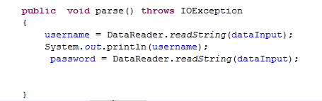
Every request class consists of..
parse() : Reads the data from the request packets and stores it into inputStream variables, making it available for the doBusiness() to manipulate.

Slide 15
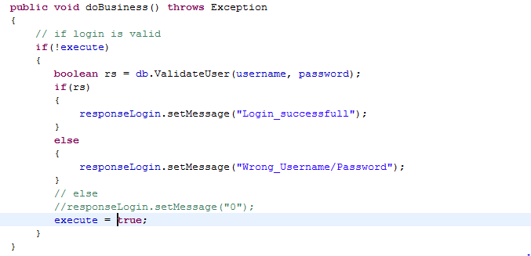
doBusiness():
Does processing of individual request, using the data in inputStream variables
And thus make the final result available to send to response method of the request class.

Slide 16

respond():
Will provide with data to corresponding response class.

Slide 17
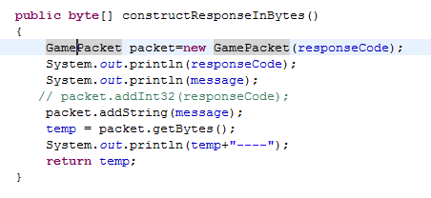
Response Processing
The response is put together by integrating :
response protocol constant related to the corresponding request class
And data which is converted into bytes by constructResponseInByte() method in every response class

Slide 18
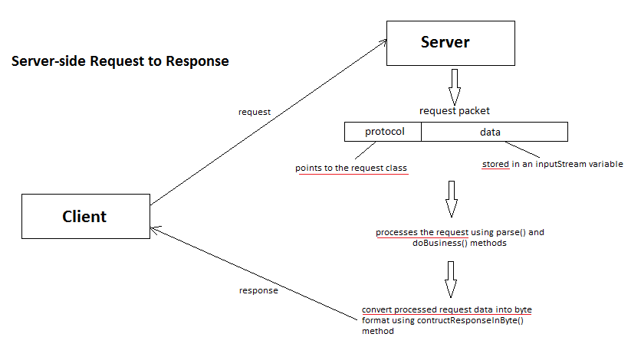

Slide 19
Abstract Request to Response flow
Initializing Server.
Then initializing Client.
The server is now listening for client requests.
If server receives any requests, a new object will be created for GameClient class and thus a new thread for this particular user client will be initialized.
From the request packet, fetching request_length and dividing it into request_protocol , which points towards a particular request class, and the remaining data in the packet is read for processing the request into a inputStream variable
For every request class, there is a corresponding response class. In this response class, construstResponseInByte() method will forward message to the client through network.

Slide 20
Models(Storage on Server side)
Chintan Shah

Slide 21
Why Model?
For the informations that need not to store in database.
ex. Character location information that not need to store in database because it frequently changes and not required to get the location back on relogin.
For store the information on server side.
ex. character’s position , control point location , NPC information
Maintain all kind of lists on server side.
ex. All characters information list , All Control point information list.
- To populate the queues of different clients , models are relatively easy storage process instead of use any other data structure.

Slide 22
What it contains?
Property declaration
Constructor initialization
ArrayList initialization
Getter Setter Methods

Slide 23
Name of all models :
CharacterModel - Store all characters information
ControlPointModel - Store all control point related details
NPCModel - Store all NPC related details
UserModel - Store user related details
SkillModel - Store skill information [Optional ]
TeamModel - Store team details [Optional]

Slide 24
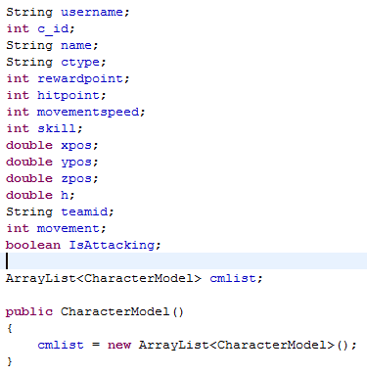
Character Model :

Slide 25
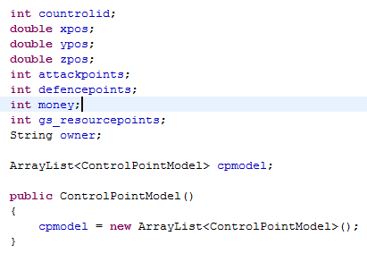
Control Point Model

Slide 26
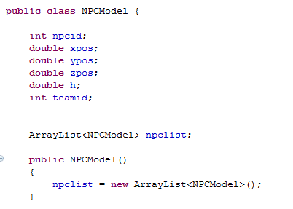
NPC Model

Slide 27
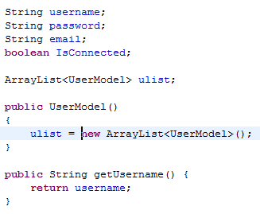
User Model

Slide 28
Demo for whole server side flow

Slide 29
Thank You

